Slide 1

The Role of Technology in Healthcare
Technology is transforming the healthcare industry, improving patient outcomes, enhancing operational efficiency, and expanding access to medical services. This presentation explores the digital innovations shaping the future of healthcare.
----- by Mibin Benny
Slide No 1

Slide 2

Introduction: The Digital Transformation of Healthcare
1
Patient-Centric Care
2
Improved Outcomes
Technology empowers patients to take a more active role in managing their health.
Innovative tools enable earlier diagnosis, personalized treatment plans, and better monitoring.
3
Enhanced Efficiency
Automation and data analytics streamline workflows, reduce errors, and lower costs.
Slide No 2

Slide 3

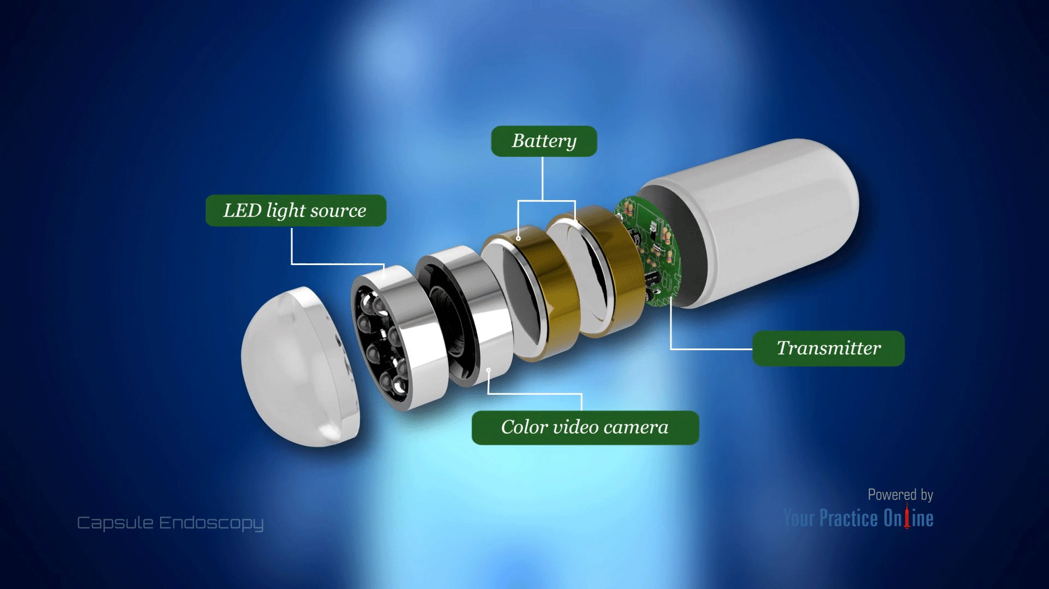
Some examples of currently used technology in health sector
Nanotechnology in Medicine
Pill Camera
Nanotechnology involves the use of nanoparticles to deliver drugs to targeted areas in the body with high precision. This is especially useful in cancer treatment, where nanoparticles can deliver chemotherapy drugs directly to cancer cells, minimizing damage to healthy tissues. Nanoparticles can also be used for imaging and diagnostics due to their extremely small size.
The pill camera is a small, ingestible capsule equipped with a camera that captures images of the inside of the digestive tract.
3D-Printed Organs and Prosthetics
3D printing is used for creating customized prosthetics, implants, and even bioprinted tissues. It also has applications in creating accurate anatomical models for pre-surgical practice.
Slide No 3

Slide 4

Artificial Intelligence in Diagnosis and Treatment
Early Detection
Personalized Treatments
AI algorithms can identify signs of disease in medical images with high accuracy.
AI systems analyze patient data to recommend tailored therapies and medication dosages.
Clinical Decision Support
Predictive Analytics
AI-powered tools assist healthcare providers in making informed, evidence-based decisions.
AI models forecast patient outcomes and identify high-risk individuals to inform preventive care.
Slide No 4

Slide 5

Robotic Surgeries : Is This The Future ?
Robotic Surgeries
Key Advantages of Robotic Surgery
Challenges and Limitations
Robotic surgery refers to a minimally invasive surgical technique where surgeons use robotic systems to perform operations with greater precision, flexibility, and control than traditional methods. These systems, typically composed of robotic arms, high-definition 3D cameras, and advanced software, allow for highly detailed and complex procedures.
Precision and Accuracy: Robotic systems allow for extremely fine, precise movements that may be difficult for human hands, reducing the risk of errors and improving surgical outcomes. These surgeries often involve smaller incisions than traditional open surgery, leading to reduced pain, shorter recovery times, and smaller scars.
Enhanced Visualization: The high-definition 3D imaging provided by the robotic system gives surgeons a better view of the surgical area, often allowing for more accurate navigation and better tissue handling.
3. Faster Recovery: Due to the minimally invasive nature of the surgery, patients generally experience faster recovery times, less blood loss, and a lower risk of infection
4. Reduced Surgeon Fatigue: Surgeons can perform long and complex procedures with less physical strain, since they operate the robotic system from a seated position, which can lead to improved concentration and less fatigue
>Cost: Robotic surgical systems are expensive, both in terms of initial investment and maintenance, which can lead to higher overall costs for patients.
>Learning Curve: Surgeons must undergo significant training to operate robotic systems effectively, which can delay their adoption and increase the risk of complications if not done correctly.
>Limited Haptic Feedback: While the robotic arms provide a high level of precision, they lack the tactile feedback (sense of touch) that human hands provide, which can make some procedures challenging for the surgeon.
>Dependence on Technology: Robotic systems can be prone to technical malfunctions, and in case of a failure, the surgeon must quickly switch to a traditional surgical method.
Slide No 5

Slide 6

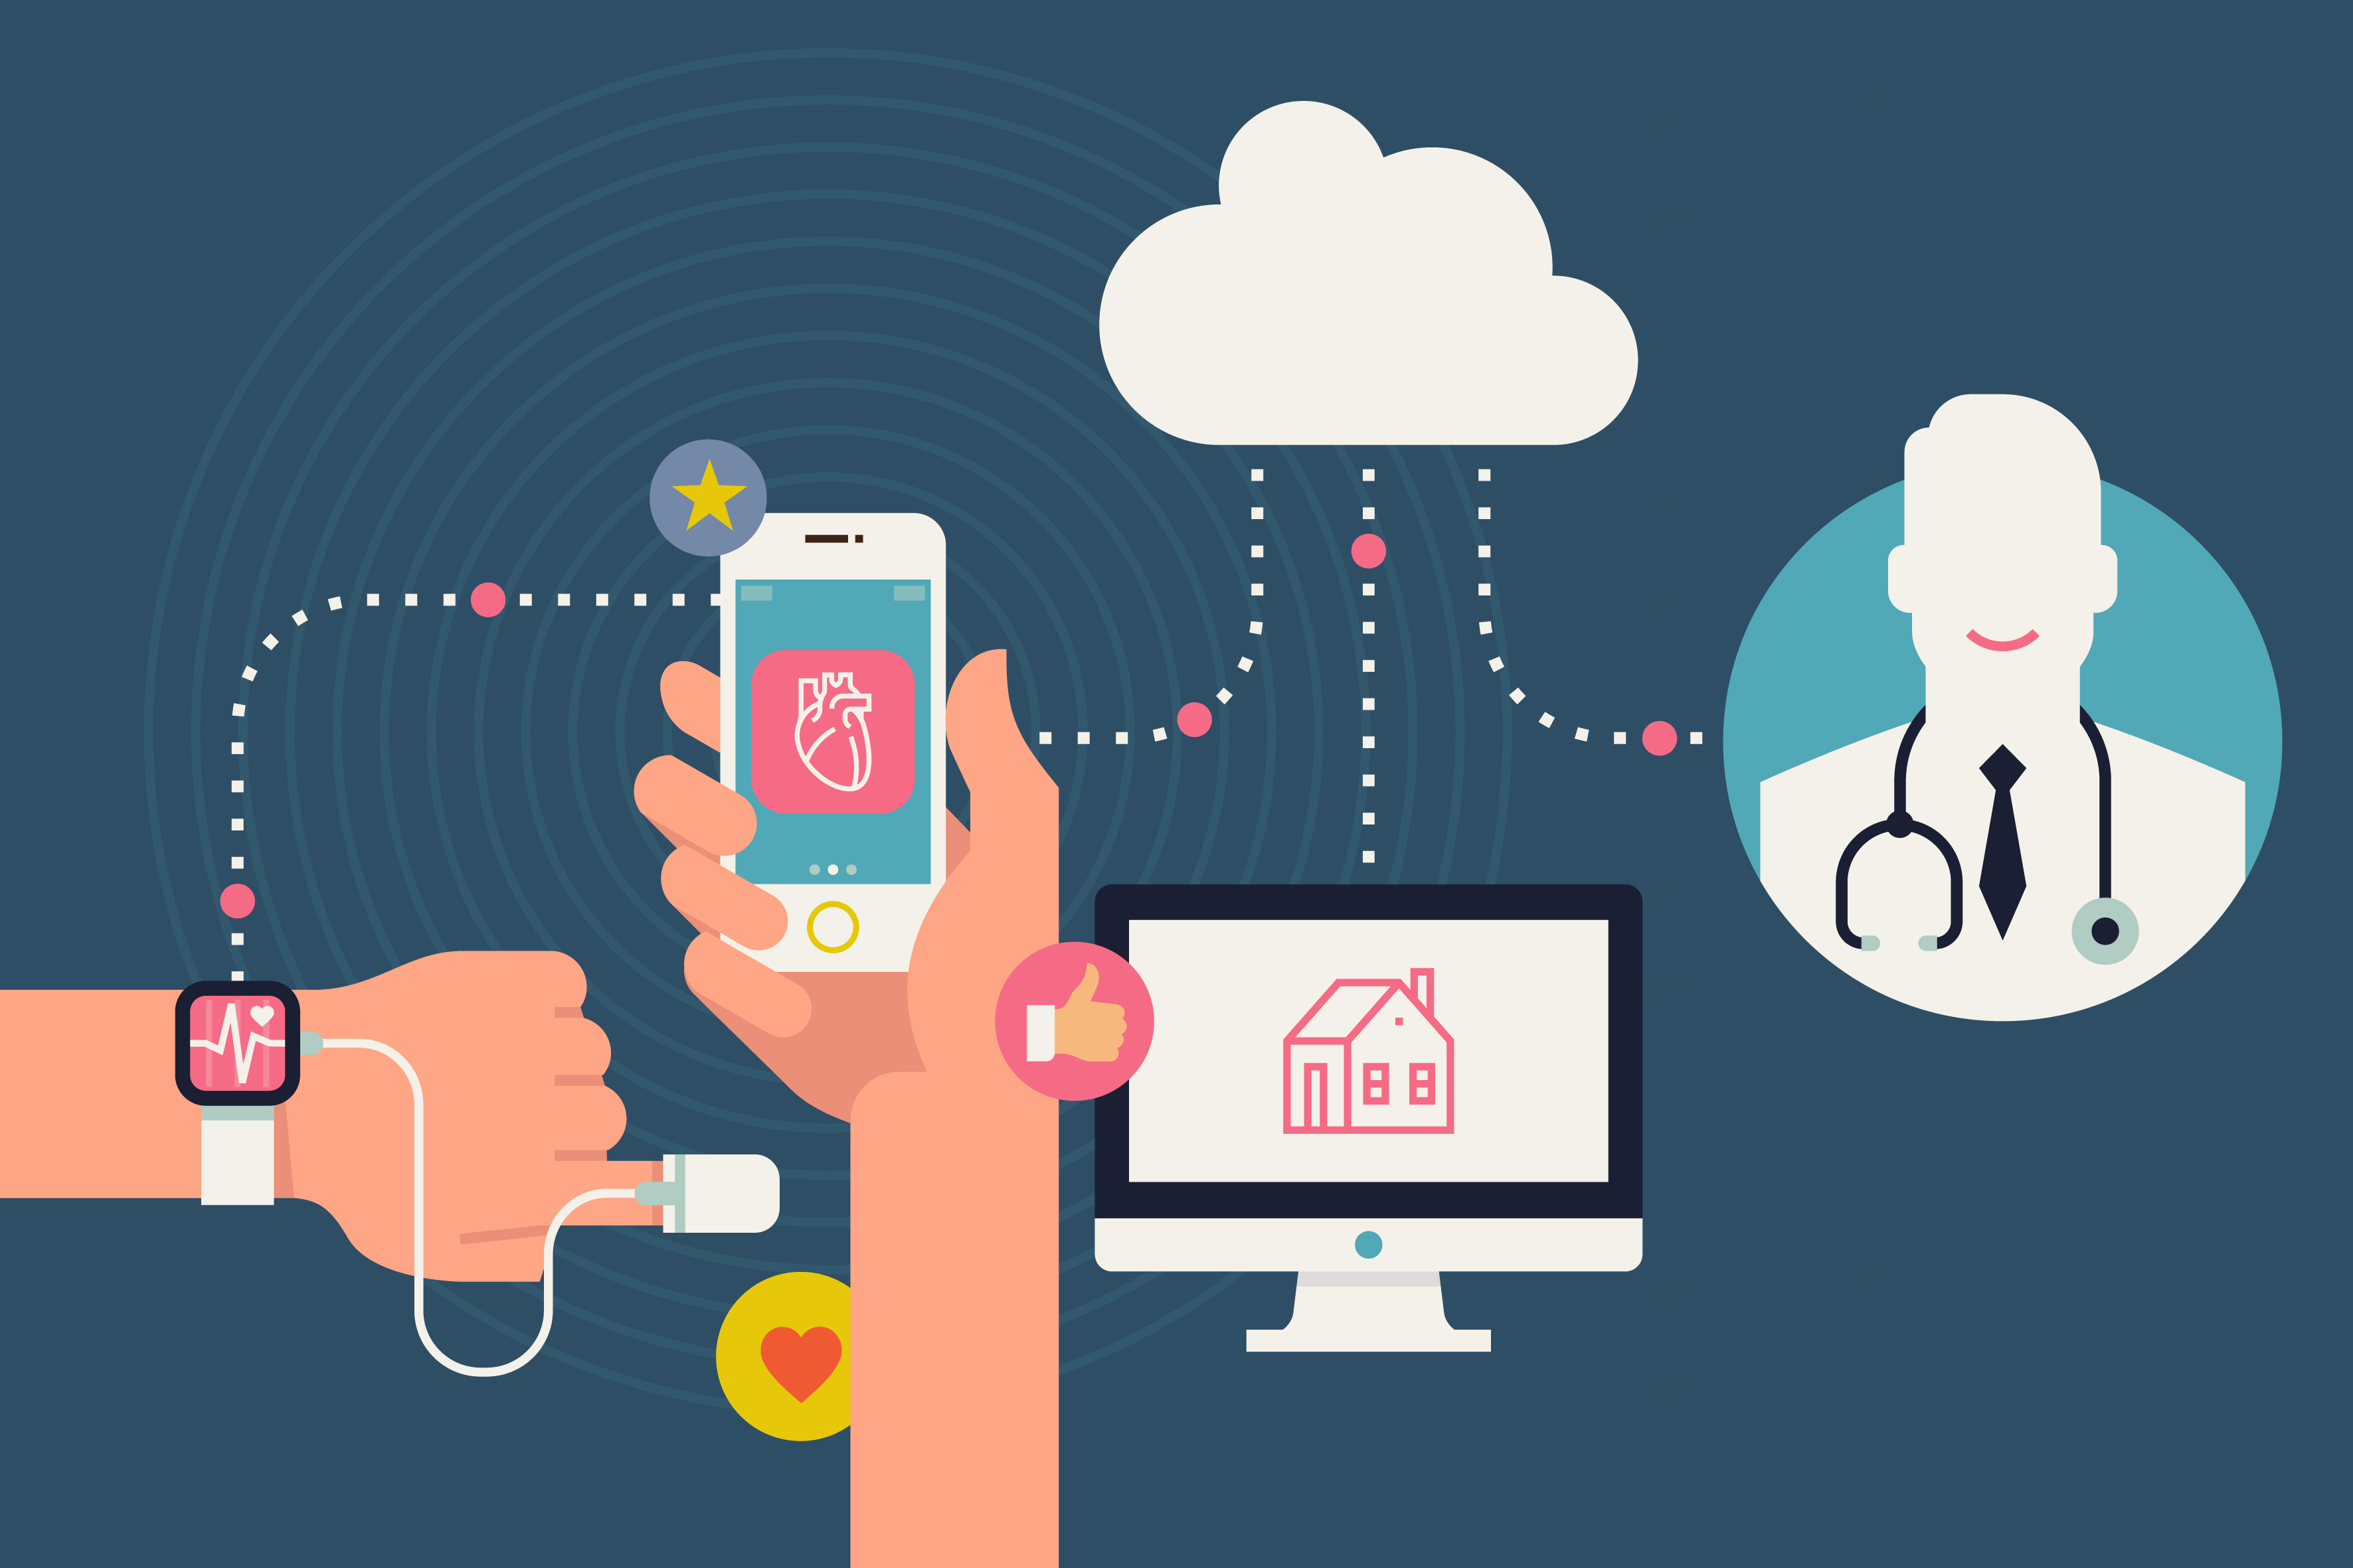
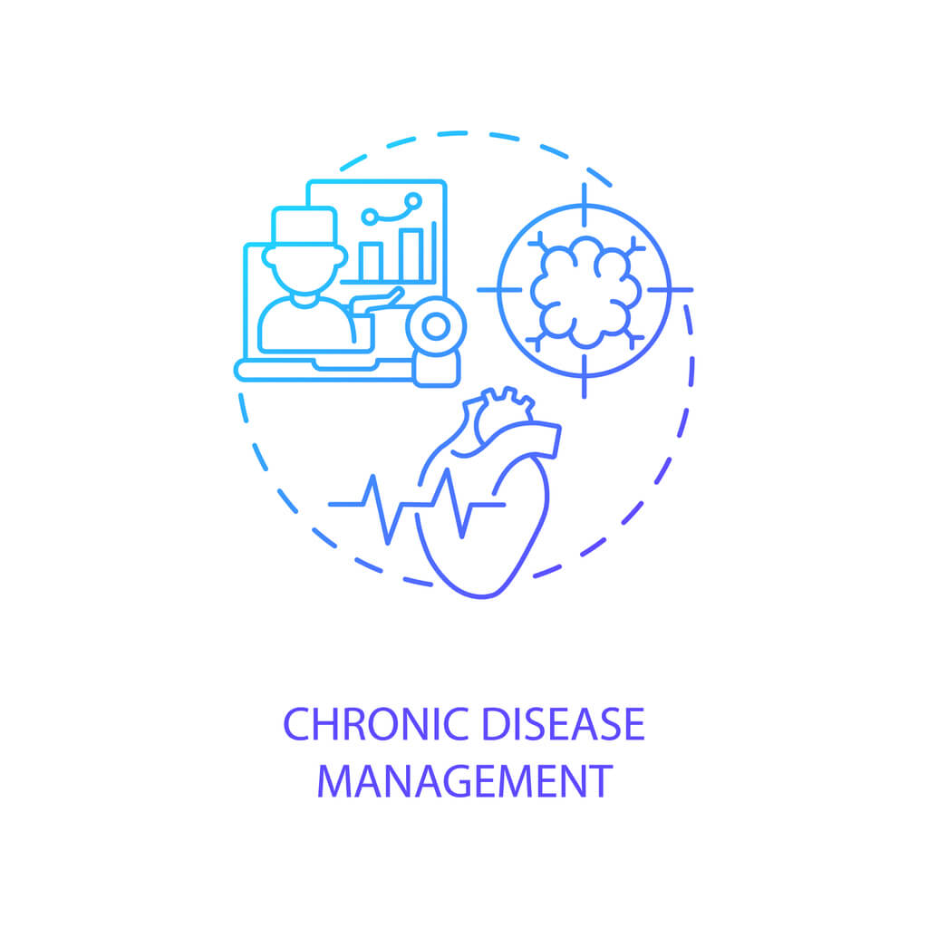
Telehealth and Remote Patient Monitoring
Telehealth
Remote Monitoring
Chronic Disease Management
Video consultations allow patients to access healthcare services remotely, improving accessibility.
Wearable devices and home-based sensors track patient data, enabling proactive care.
Remote technologies help patients manage conditions like diabetes, heart disease, and COPD.
Slide No 6

Slide 7
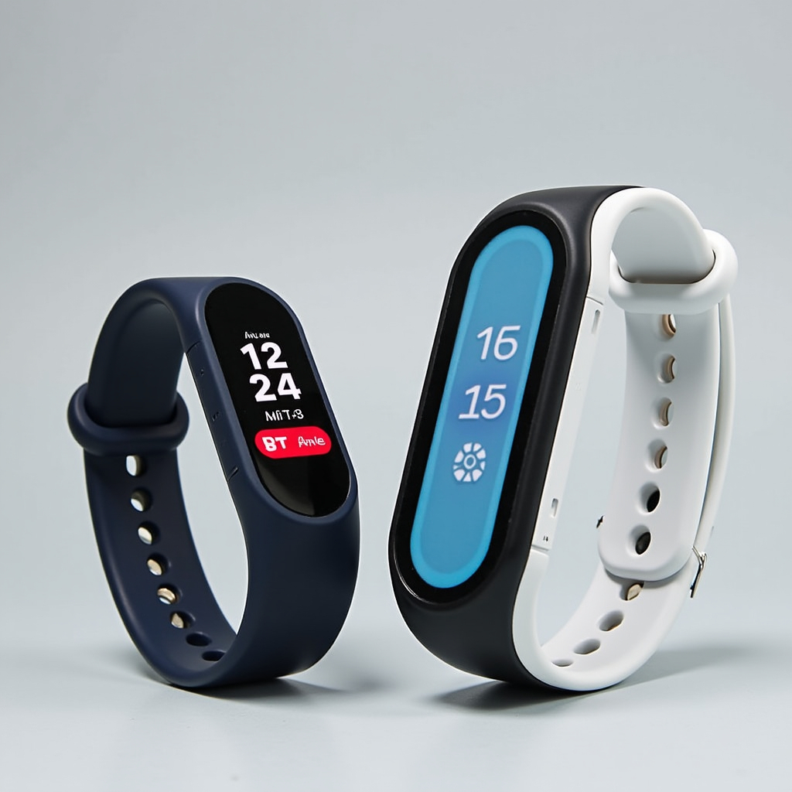






Wearable Devices for Continuous Health Tracking
Heart Rate Monitoring
Sleep Tracking
Wearables track heart rate to detect irregularities and monitor cardiovascular health.
Wearable sensors analyze sleep patterns to identify issues and recommend improvements.
Activity Tracking
Blood Oxygen Monitoring
Wearables measure physical activity, calories burned, and other fitness metrics.
Wearable devices can detect changes in blood oxygen levels, a critical health indicator.
Slide No 7

Slide 8

Electronic Health Records and Data Analytics
1
Data Centralization
Electronic health records (EHRs) consolidate patient data from various sources.
2
Improved Accessibility
EHRs allow healthcare providers to access patient information securely and efficiently.
3
Data-Driven Insights
Analytics uncover patterns and trends to support clinical decision-making and population health management.
Slide No 8

Slide 9




Blockchain Technology for Secure Health Data
Enhanced Security
Interoperability
Patient Empowerment
Blockchain's decentralized, tamper-resistant nature protects sensitive patient data.
Blockchain facilitates secure sharing of health information across different systems and providers.
Patients can control access to their own medical records using blockchain technology.
Slide No 9

Slide 10

Ethical Considerations and Regulatory Challenges
1
Privacy and Data Governance
2
Bias in AI
3
Regulatory Oversight
Health data is highly sensitive, and with the increased use of EHRs and wearables, patient data is being stored. This raises concerns about data breaches, unauthorized access, and misuse of personal health information.
AI algorithms are only as good as the data they are trained on. If the training data is biased it can lead to biased outcomes in diagnoses, treatment recommendations, or healthcare access.
Governments and regulatory bodies must keep pace with the rapid evolution of healthcare technology.
Slide No 10

Slide 11

Conclusion: The Future of Tech-Enabled Healthcare
As technological innovations continue to disrupt the healthcare industry, the future promises more personalized, efficient, and accessible medical care. By embracing these advancements, we can transform the patient experience and improve health outcomes for all. Technology in healthcare is transforming how we diagnose, treat, and manage health. However, for these advancements to be effective and equitable, challenges related to privacy, accessibility, and ethical use must be addressed. As the healthcare sector continues to adopt and integrate technology, its future will undoubtedly be shaped by ongoing innovation and thoughtful regulation.
Slide No 11

Slide 12


